Slide 1
Postgraduate Student Orientation 2026
Your Career
Sarah Jones (she/her) Careers Consultant
Kate Ivanchenko (she/her) Student Employability Officer
Trinity Careers Service
  www.tcd.ie/Careers

Slide 2
Agenda
Introductions, our websites & online platforms
Overview of “Map My Future” & “MyCareer”
Overview of Practical Services incl those tailored for International & PhD Students
Our “Career Skills” Award
Conclusion
Questions and Comments

Slide 3
Two Careers Services at Trinity
Trinity Careers Service
Trinity Business School
Careers & Community Team

Slide 4
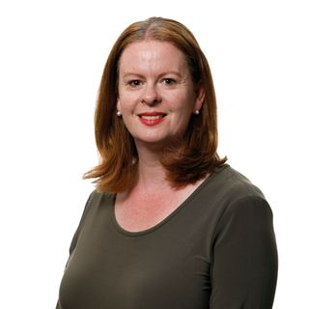
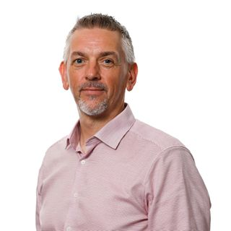











The Careers & Community Team
Ruth O’Leary
Head of Careers and Community
Conor Edwards
Alumni & Corporate
Relations Manager
Aoife Fitzpatrick
Employer Engagement
Kate Burke
Careers Consultant
Victoria Lawlor
Careers Consultant
Patrick Phillips
Careers Consultant
Krystyna Harney
Careers Consultant
Mark Heeney
Careers Consultant
Adrian McHugh
Careers Administrator
businesscareers@tcd.ie

Slide 5

Trinity Business School Careers & Community Team
Explore your career options, prepare effectively for your next career move, and gain the skills required to help you reach your full potential.
Year-round Careers Workshops on a variety of topics
Careers Fairs, employer presentations and networking events
Online careers resources like 12twenty, Vmock, Shortlist.me and CareerLeader
The Trinity Business School
Postgraduate Careers Platform
Book an appointment (Zoom or in person)
Register for events
Manage your job search
Find & apply for opportunities
Connect with alumni
View salary data
Register Today!
Email: business.careers@tcd.ie

Slide 6
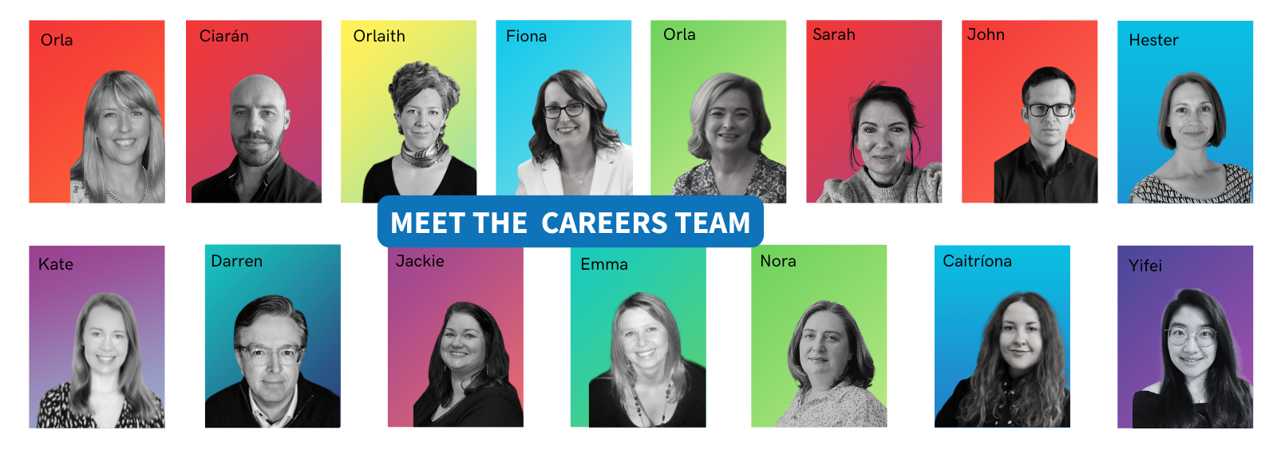
Meet the Careers Team

Slide 7














Balance career & life
Consider the career- life balance that works for you and know your rights
See the
big picture
Identify ways that your
work can impact on the
wider world and how
external factors can affect your career
Supporting Students and
Recent Graduates to succeed
Start where you are
Reflect on who
you are and where
you want to
go in your career
Create opportunities
Try new things,
meet new people
grow your network
Explore possibilities
Explore possibilities
and learn about recruitment processes
and workplace
culture
Build
your career
Actively develop
your career and
skills and make decisions that are
best for you
for further information contact:
www.tcd.ie/careers

Slide 8



http://mycareerconnect.tcd.ie
Book Appointments & Events:
1-1 Guidance, CV Clinics, Interview Practice etc.
Find Opportunities:
Search and apply for vacancies, research employers and find
postgraduate courses and funding
Ask a Query:
Ask questions 1-on-1 with
your Career Consultants without
needing to book appointments

Slide 9

Career Services at Trinity College Dublin
Careers Supports for You
Awards and Opportunities for PG
Career Skills Award
Careers & Employability modules for PhD students
1-1 Career Guidance for all
CV & LinkedIn Review Clinics
Practice Interviews
Career Fairs
Employer Events & Opportunities
Psychometric Tools
Meet us in person or online
Mentoring
Get in touch
www.tcd.ie/careers for information and advice and to access MyCareer to book our services
Follow our:
Instagram @trinity.careers.service for careers news and advice
Graduate Stories Podcast
Email: careers@tcd.ie
Opportunities to connect with Trinity’s Global Alumni, explore careers and get advice

Slide 10



Supports with job applications and interview technique
Job application and future of work guides
Navigating the graduate world with my disability….
Practice your Interview strategy available 24/7 with
Shortlist.me

Slide 11

Trinity Careers Fairs

Slide 12

Join LinkedIn Group: Alumni Mentoring at Trinity College Dublin

Slide 13




International Students
Find out about your rights when living, studying and working in Ireland at www.internationalstudents.ie
For queries about immigration and visas, contact the Immigration and Support Officer, Trinity Global Room tcdglobalroom@tcd.ie
For information on work permits, visit the Department of Enterprise,
Trade and Employment website at www.enterprise.gov.ie
Find more advice and resources for international students at our website www.tcd.ie/Careers/students/international.php

Slide 14
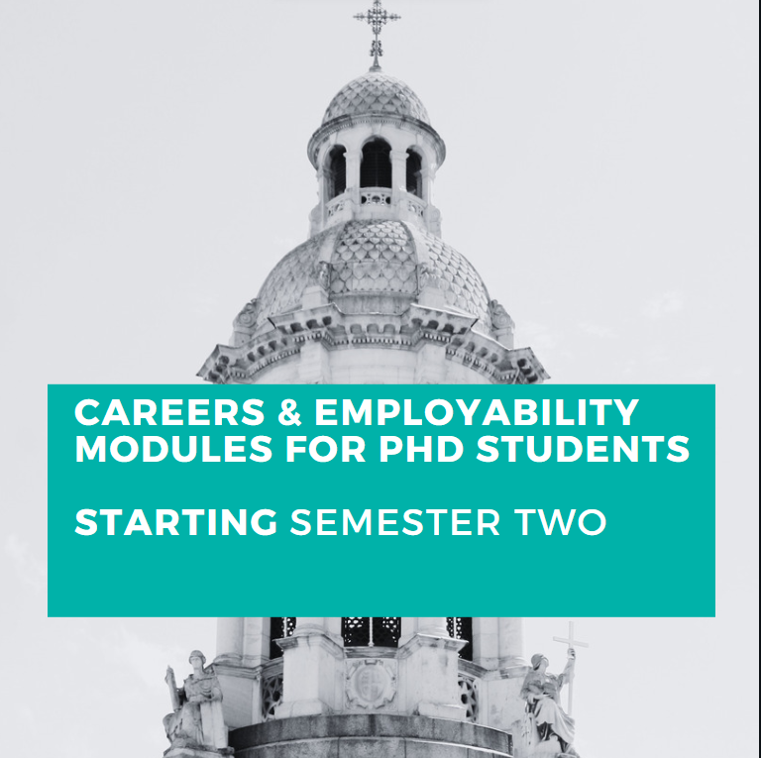
5 and 10 ECTS Accredited Modules for PhD Students
Discover the skills to develop through your PhD relevant to the workplace
Create a career path that reflects what is important to you
Strategies to proactively manage your career
Create connections with alumni and other PhD students
Complete a work-based learning experience (secured by the student) (10 ECTS module only)

Slide 15


Trinity Career Skills Award
The award equips you with the advantage you need to launch your career. Get involved with workshops, connect with employers, and gain experience.

Slide 16
Gain industry insights and connect with employers and organisations across different sectors.
Why is the award important?
Builds practical transferable skills and competencies valued by employers through interactive workshops and activities.
Identify and showcase your valuable skills gained through academic and extracurricular activities.
Enhance your CV and become a stand-out job applicant.

Slide 17
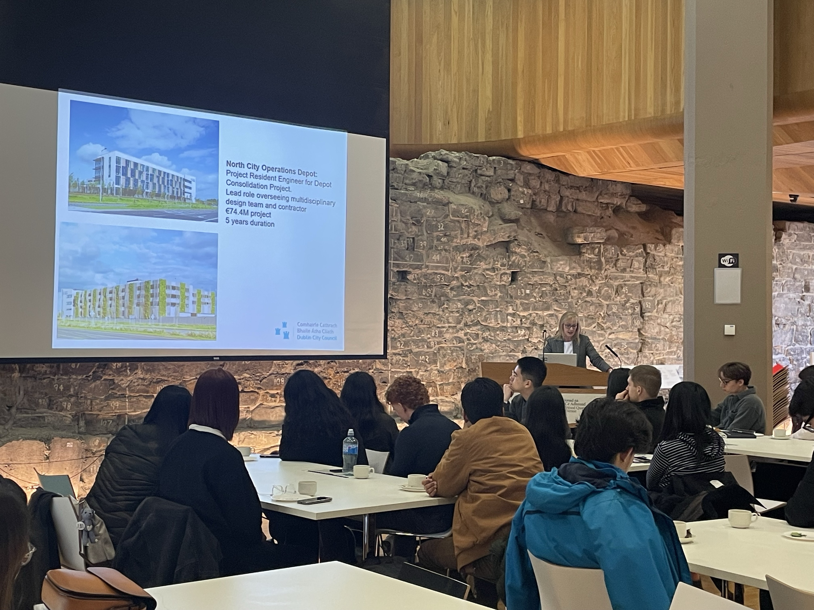
Award Components
To earn the Career Skills Award, you must complete each category:
Employer Partnership Skills Workshops
Develop Yourself Beyond the Classroom
Experiential Learning

Slide 18
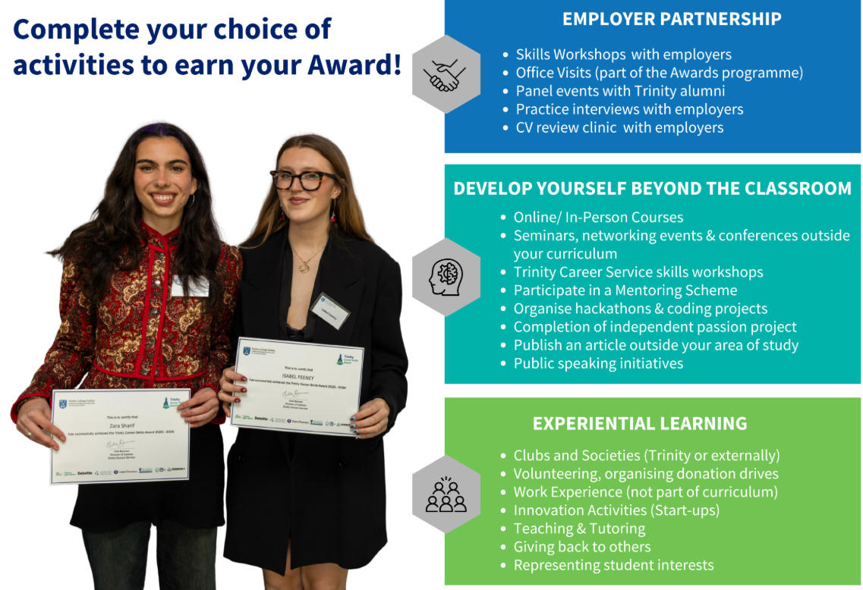

Slide 19
Career Skills Award Levels
Participation Level
2 Employer Partnership activities
1 Develop Yourself Beyond the Classroom activity
Achievement Level
3 Employer Partnership activities
Exceptional Level
4 Employer Partnership activities
2 Develop Yourself Beyond the Classroom activities
1 Experiential Learning activity (min 20 hours)
1 Experiential Learning activity (min 20 hours)
2 Develop Yourself Beyond the Classroom activities
A reflection exercise on overall experience of the Award
2 Experiential Learning activities (min 20 hours each)
A reflection exercise on overall experience of the Award

Slide 20

5th October 5:30 - 6:30pm | Deloitte
8st October 5-6 pm | Make Your Skills Count | Trinity Careers Service
22nd October 6 – 7 pm | Amazon
5th November 6 – 7 pm | Version 1
12th November 6-7 pm | Dublin City Council
18th November 5:30-6:30pm | Dublin Simon Community
30th November 6-7 pm | Rehab
Term 1 Skills Workshop Schedule

Slide 21
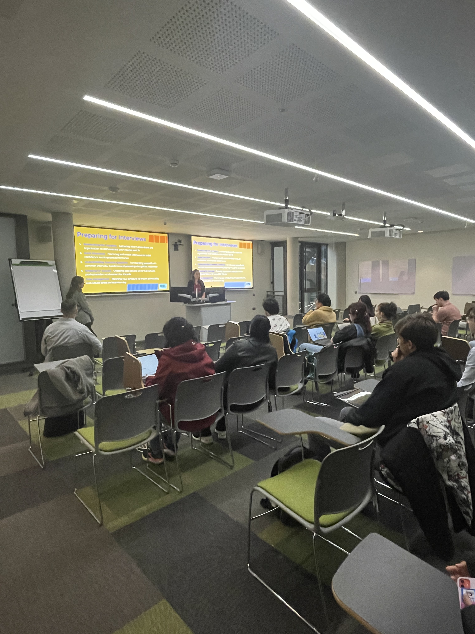
Any student can register for the Award via MyCareer through the Pathway
All activities must be completed before March 19th, 2027
Receive your certificate and celebrate your success with us at the end of the Programme
Registering for the Award

Slide 22
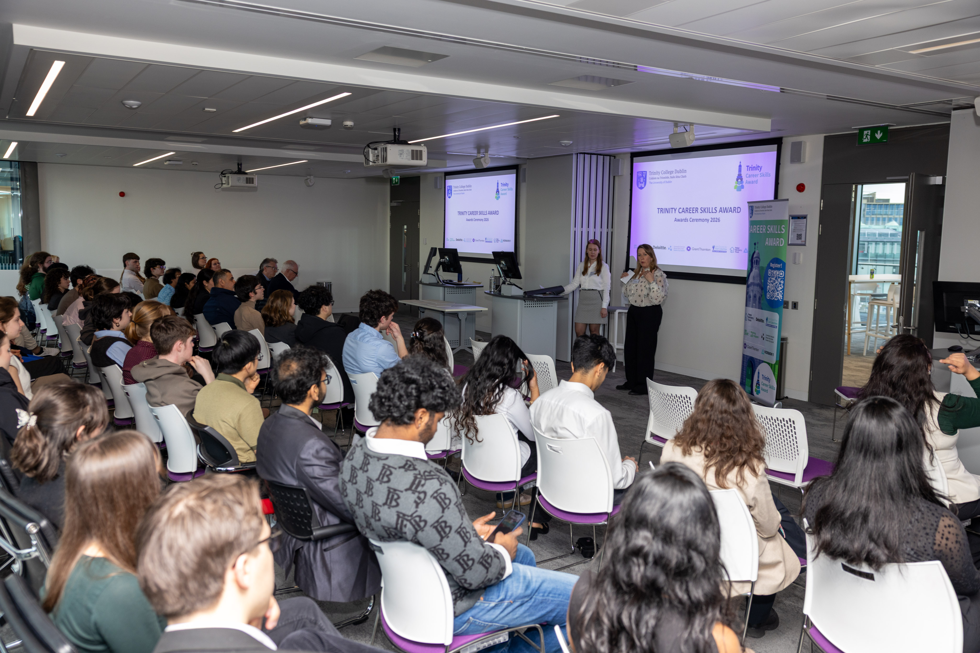
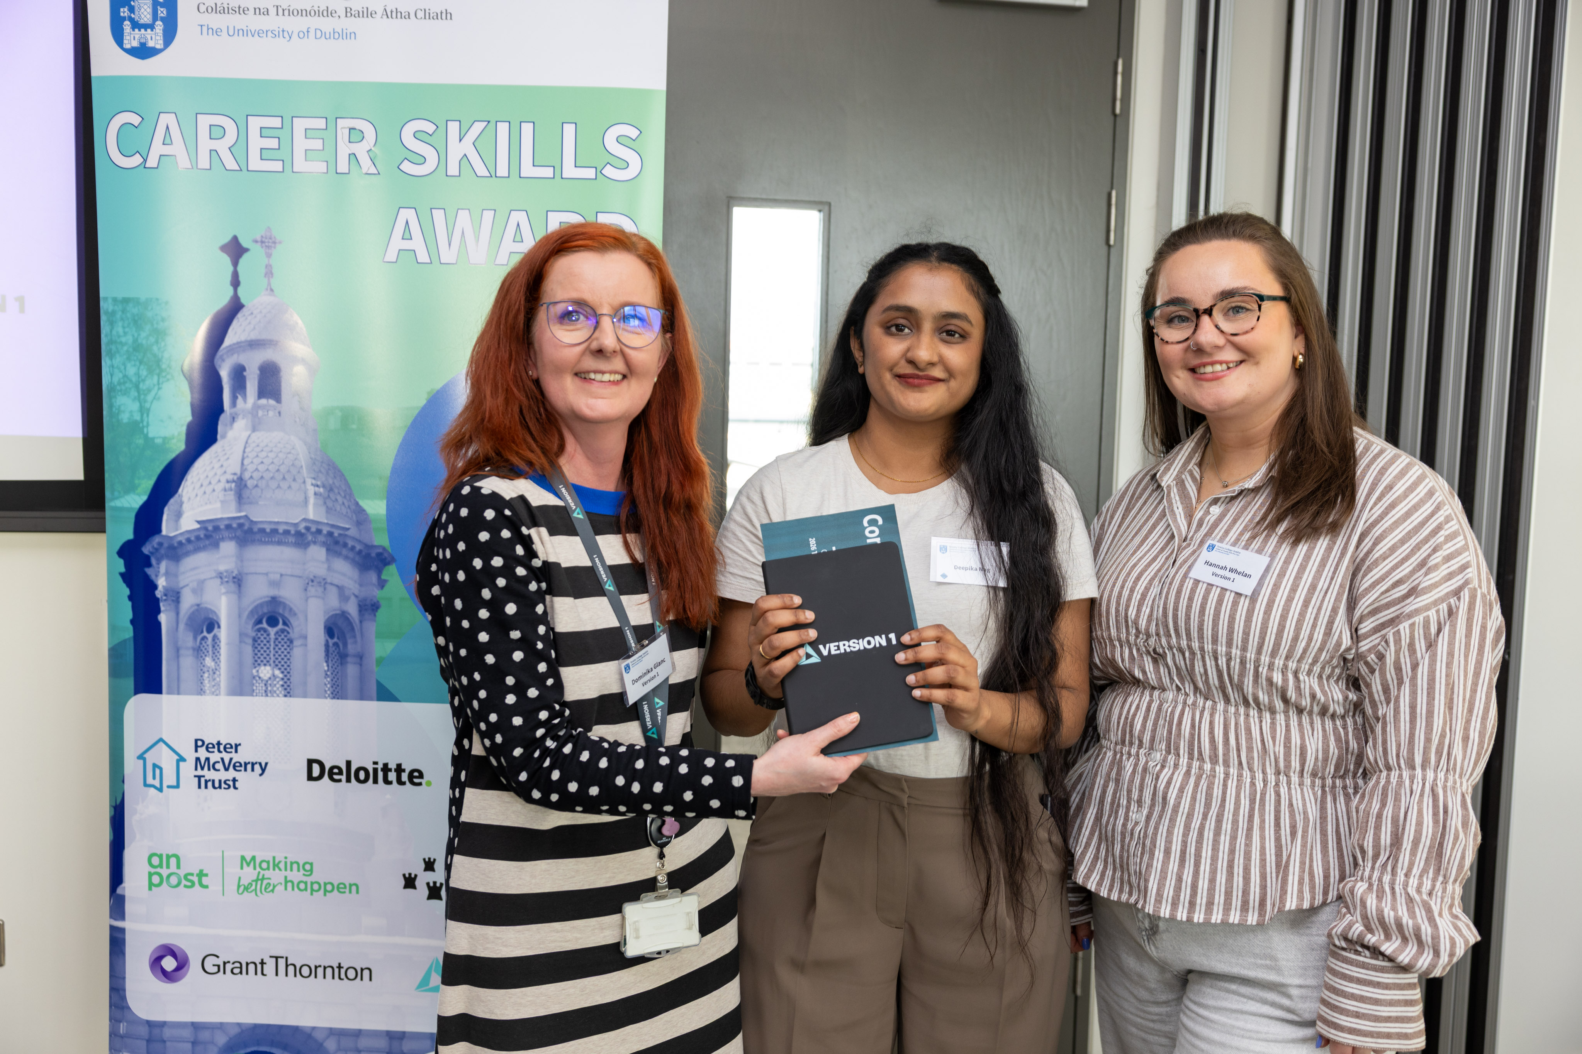

Career Skills Award Ceremony 2026
Version 1 Prize Winner | CSA Ceremony 2026

Slide 23

Trinity Career Skills Award
For any questions about the Award, please contact us via email employability@tcd.ie

Slide 24

Summary- Calls to Action
  Log in to Trinity Careers Service portal MyCareer (all students)
  Sign in to Trinity Business School Postgraduate careers platform 12Twenty (Trinity Business School students only)
  Interested in the Career Skills Award? Register on MyCareer [Pathways]
  Looking for a job after graduation? Attend an Employer Fair; Book a CV/LinkedIn/ Cover Letter Review
  Interested in growing your network? Join LinkedIn: Alumni Mentoring at Trinity College Dublin and attend a Career Inspiration Event

Slide 25

Questions & Comments
Sarah Jones, Careers Consultant
Kate Ivanchenko, Student Employability Officer
Trinity Careers Service

